Slide 1
Object Oriented Programming Design
Dr RAMYA DEVI M
Computer Science and Information Systems
CS - 01 : 28th Jun 2025

Slide 2
Course Outcomes
On completion of this course we will be able to:
Demonstrate sound understanding of Object oriented concepts and able to design applications having to apply OOP paradigms.
Express the OOP concepts in form of code snippet, small applications having to recognize the differences between procedural and OOP concepts.
Design applications using the various constructs and features available in the programming language and assess them.
9/15/2011
Object Oriented Programming using JAVA
3

Slide 3
Books
The Java Programming Language, Ken Arnold, David Holmes, James Gosling, Prakash Goteti, 3rd Edition, Pearson.
Java: The Complete Reference by Herbert Schildt, 9th Edition, 2017.

Slide 4
JAVA Basics

Slide 5
Why Java is Important
Two reasons :
  Trouble with C/C++ language is that they are not portable and are not platform independent languages.
  Emergence of World Wide Web, which demanded portable programs
Portability and security necessitated the invention of Java

Slide 6
History
James Gosling - Sun Microsystems
Co founder – Vinod Khosla
Oak - Java, May 20, 1995, Sun World
JDK Evolutions
– JDK 1.0 (January 23, 1996)
– JDK 1.1 (February 19, 1997)
– J2SE 1.2 (December 8, 1998)
– J2SE 1.3 (May 8, 2000)
– J2SE 1.4 (February 6, 2002)
– J2SE 5.0 (September 30, 2004)
  Java SE 6 (December 11, 2006)
  Java SE 7 (July 28, 2011)

Slide 7
Cont..
Java Editions.
  J2SE(Java 2 Standard Edition) - to develop client-side standalone applications or applets.
  J2ME(Java 2 Micro Edition ) - to develop applications for mobile devices such as cell phones.
  J2EE(Java 2 Enterprise Edition ) - to develop server-side applications such as Java servlets and Java ServerPages.

Slide 8
What is java?
A general-purpose object-oriented language.
Write Once Run Anywhere (WORA).
Designed for easy Web/Internet applications.
Widespread acceptance.

Slide 9
How is Java different from C…
C Language:
  Major difference is that C is a structure oriented language and Java is an object oriented language and has mechanism to define classes and objects.
  Java does not support an explicit pointer type
  Java does not have preprocessor, so we cant use #define,
#include and #ifdef statements.
  Java does not include structures, unions and enum data types.
  Java does not include keywords like goto, sizeof and typedef.
  Java adds labeled break and continue statements.
  Java adds many features required for object oriented programming.

Slide 10
How is Java different from C++…
C++ language
Features removed in java:
  Java doesn’t support pointers to avoid unauthorized access of memory locations.
  Java does not include structures, unions and enum data types.
  Java does not support operator over loading.
  Preprocessor plays less important role in C++ and so eliminated entirely in java.
  Java does not perform automatic type conversions that
result in loss of precision.

Slide 11
Cont…
Java does not support global variables. Every method and variable is declared within a class and forms part of that class.
Java does not allow default arguments.
Java does not support inheritance of multiple super classes by a sub class (i.e., multiple inheritance). This is accomplished by using ‘interface’ concept.
It is not possible to declare unsigned integers in java.
In java objects are passed by reference only. In C++ objects may be passed by value or reference.

Slide 12
Cont …
New features added in Java:
Multithreading, that allows two or more pieces of the same program to execute concurrently.
C++ has a set of library functions that use a common header file. But java replaces it with its own set of API classes.
It adds packages and interfaces.
Java supports automatic garbage collection.
break and continue statements have been enhanced in java to accept labels as targets.
The use of unicode characters ensures portability.

Slide 13
Advantage of Java
Java is simple
Java is object-oriented
Java is distributed
Java is interpreted
Java is robust
Java is architecture-neutral
Java is portable
Java’s performance
Java is multithreaded
Java is dynamic
Java is secure

Slide 14
Java Environment
Java includes many development tools, classes and methods
  Development tools are part of Java Development Kit (JDK) and
  The classes and methods are part of Java Standard Library (JSL), also known as Application Programming Interface (API).
JDK constitutes of tools like java compiler, java interpreter and many.
API includes hundreds of classes and methods grouped into several packages according to their functionality.

Slide 15
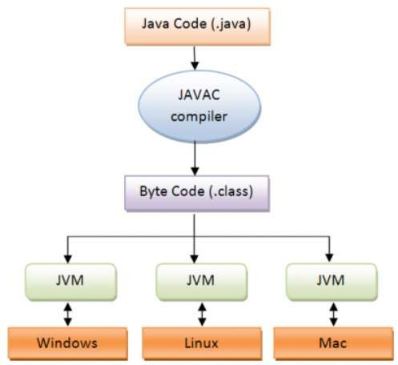
Java is architecture-neutral
17

Slide 16
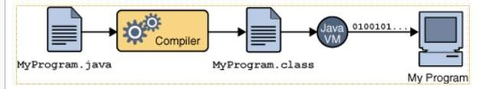
WORA(Write Once Run Anywhere)
Java programs are compiled to Java byte-codes, a kind of machine independent representation.
The program is then executed by an interpreter called the Java Virtual Machine (JVM).
18

Slide 17
Module 1 – Lecture 1
BASICS IN JAVA

Slide 18
JAVA BASICS
JAVA was developed by Sun Microsystems Inc in 1991, later acquired by Oracle Corporation. It was developed by James Gosling and Patrick Naughton.
It is a simple programming language.
Writing, compiling and debugging a program is easy in java.
It enables creating modular programs and reusable code.
The following are common java terms
Java Virtual Machine (JVM)
This is generally referred as JVM.
Before, we discuss about JVM lets see the phases of program execution which are as follows: we write the program, then we compile the program and at last we run the program.
Object Oriented Programming , Lecture 1

Slide 19
JAVA BASICS
Writing a program in Java – requires knowledge of character set, the tokens, the syntax and other programming constructs.
Compilation of program is done by javac compiler.
javac is the primary java compiler included in java development kit (JDK).
It takes java program as input and generates java bytecode as output.
3) In third phase, JVM executes the bytecode generated by compiler.
This is called program run or execution phase.
The primary function of JVM is to execute the bytecode produced by compiler.
Object Oriented Programming , Lecture 1

Slide 20
JAVA BASICS
Each operating system has different JVM, however the output they produce after execution of bytecode is same across all operating systems.
That is why we call java as platform independent language.
Bytecode
As discussed above, javac compiler of JDK compiles the java source code into bytecode so that it can be executed by JVM.
The bytecode is saved in a .class file by compiler.

Slide 21
JAVA BASICS
Java Development Kit(JDK)
As the name suggests this is complete java development kit that includes JRE (Java Runtime Environment), compilers and various tools like JavaDoc, Java debugger etc.
In order to create, compile and run Java program we would need JDK installed on our computer.
Java Runtime Environment(JRE)
JRE is a part of JDK which means that JDK includes JRE.
JRE includes JVM, browser plugins and applets support.
Object Oriented Programming , Lecture 1

Slide 22
Features of Java
Main features of Java
The following are the features of Java language
Simple
Object oriented language
Architecture Neutral
Secured
High performance
Multithreaded
Dynamic
Distributed
Database connectivity
Object Oriented Programming , Lecture 1

Slide 23
Features of Java
1.Simple
Java is a simple language.
We can easily learn it when we have better knowledge in Object oriented methodology.
Most of the syntax in Java are inherited from C and C++.
2.Object oriented language
It supports the features of object oriented programming concept.
The following are the principles of object oriented systems.
a. Encapsulation
b. Polymorphism
c. Inheritance
d. Abstraction
Object Oriented Programming , Lecture 1

Slide 24
Features of Java
a.Encapsulation - Encapsulation is defined as the wrapping up of data under a single unit.
It is the mechanism that binds together code and the data it manipulates.
Other way to think about encapsulation is, it is a protective shield that prevents the data from being accessed by the code outside this shield.
b.Polymorphism - The word polymorphism means having many forms.
In simple words, we can define polymorphism as the ability of a method behaving differently in different situations.
Real life example of polymorphism: A person at the same time can have different characteristic and roles. Like a man at the same time is a father, a husband, an employee.
Object Oriented Programming , Lecture 1

Slide 25
Features of Java
c. Inheritance - The process by which one class acquires the properties (data members) and functionalities (methods) of another class is called inheritance.
The aim of inheritance is to provide the reusability of code so that a class has to write only the unique features and rest of the common properties and functionalities can be extended from the another class.
Child Class:
The class that extends the features of another class is known as child class, sub class or derived class.
Parent Class:
The class whose properties and functionalities are used (inherited) by another class is known as parent class, super class or Base class.
Object Oriented Programming , Lecture 1

Slide 26
Features of Java
d. Abstraction – Hiding the complex parts of the program from the end user.
3. Robust
Robust means reliable. Main reason for programming failures are
Memory management mistakes
Mishandled exceptional conditions (Run time)
Java programming language is developed in a way that puts a lot of emphasis on early checking for possible errors, that’s why java compiler is able to detect errors that are not easy to detect in other programming languages.
The main features of java that makes it robust are garbage collection, Exception Handling and memory allocation.
Object Oriented Programming , Lecture 1

Slide 27
Features of Java
4. Architecture Neutral
A java program is compiled to create the byte code.
Byte code is the collection of instructions that can be executed on a special machine called as Java Virtual Machine (JVM).
But any machine can be converted into JVM by implementing java interpreter in it.
5. Secured
Java is a secured language. Security is achieved in many ways. Two important constraints are
Using Encapsulation
2. No support for pointers
Object Oriented Programming , Lecture 1

Slide 28
Features of Java
6. High performance
Performance is the prime characteristic of any system which is mostly measured on the time required to get the solution.
A system’s performance is reduced if it has lots of unwanted information (Garbage).
Java performs the garbage collection automatically.
So the garbage is cleaned automatically over a period of time.
Java also has a special built - in class called as “gc” to do garbage collection explicitly.
Object Oriented Programming , Lecture 1

Slide 29
Features of Java
7. Distributed
In Java, we can split a program into many parts and store these parts on different computers.
A Java programmer sitting on a machine can access another program running on the other machine.
This feature in Java gives the advantage of distributed programming, which is very helpful when we develop large projects. J
Java helps us to achieve this by providing the concept of RMI (Remote Method Invocation) and EJB (Enterprise JavaBeans).
Object Oriented Programming , Lecture 1

Slide 30
Features of Java
8. Multi-threaded and Interactive
A thread is an independent path of execution within a program, executing concurrently.
Multithreaded means handling multiple tasks simultaneously or executing multiple processes of the same program in parallel.
Object Oriented Programming , Lecture 1

Slide 31
Features of Java
9. Dynamic and Extensible
We can add classes and add new methods to classes, creating new classes through the property of inheritance.
This makes it easier for us to expand our own classes and even modify them.
Java gives the facility of dynamically linking new class libraries, methods, and objects. I
It is highly dynamic as it can adapt to its evolving environment.
Java even supports functions written in other languages such as C and C++ to be included in Java programs.
These functions are called “native methods”.
These methods are dynamically linked at runtime.
Object Oriented Programming , Lecture 1

Slide 32
Features of Java
10. Database Connectivity
Java language is used to create a database environment.
For example, a Relational Database can be accessed with Java language by implementing JDBC and ODBC connectivity.
11. Network programming
Java supports network programming.
This is the prime feature of this language.
By writing program in Java, it is possible to send and receive messages / information between two or multiple users.
And the list goes on including Exbedded systems, IOT, Mobile computeing, etc.
Object Oriented Programming , Lecture 1

Slide 33
Object Oriented Paradigm

Slide 34
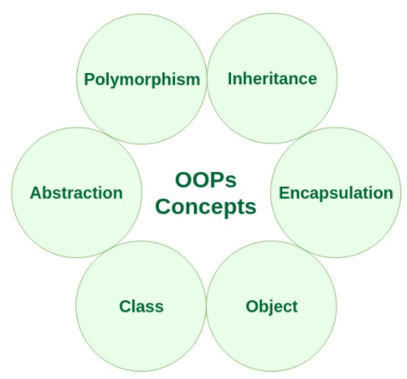
Characteristics of OOP
16CS5201 / Computer Networks

Slide 35
Topics
What is an Object ?
Graphical View of an Object
Object Examples
What is a Class ?
Object vs Class ?
Class Examples

Slide 36
What is Object ?
Object Means Combination of Data (Attributes) and Logic (Algorithm, Behavior, Functions, Operations) of some real world entity. For example Student, Box, Account, Time
Every real-world object has two characteristics :
  Data-Part/State [Also known as attributes or properties]
  Behavior [Also known as operations / Algorithmic / Logic Part]
Software Object is conceptually similar to a every real-world object.

Slide 37
Object: Graphical View
Object Keeps State/Data Part and Behavior/Logic Part Together
State/Data Part
Operations/Logic/Algorithmic Part
A Software Object

Slide 38
Object Examples
Box Object :
  State/Data Part : length, width, height, Color [Attributes/Instance Fields]
  Behavior Part: computing area, computing volume [Operations, Methods]
Dog Object :
  State/Data Part : name, breed, color [Attributes / Instance Fields]
  Behavior Part : barking, fetching, wagging [Operations, Methods]
Account Object :
  State/Data Part : account number, account holder name, balance, type of account [Attributes/ Instance Fields]
  withdrawing an amount, depositing an amount, checking balance of a account [ Behavior, Operations, Methods]

Slide 39
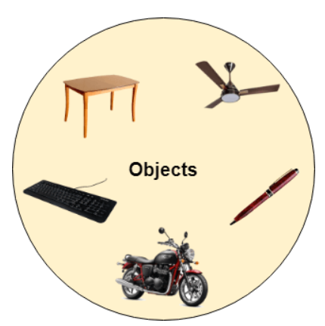
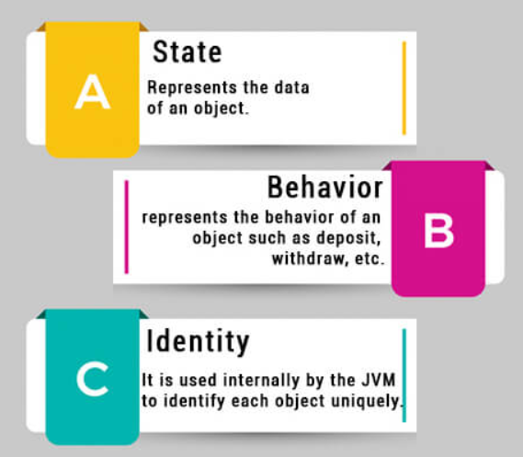
Object Examples

Slide 40

Object Examples
Box as a Real World Object
Box as a Software Object
computing area
length, width, height, color
computing volume
Dog as a Software Object
Dog as a Real World Object
barking
name, breed, color
fetching
wagging
Object-Oriented Programming (CS F213)

Slide 41
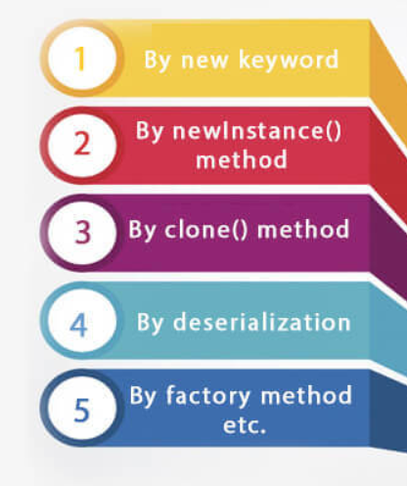
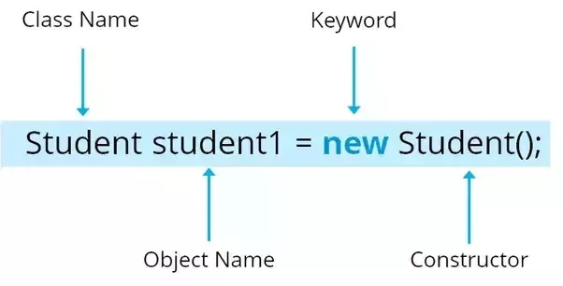
Object
Syntax:
classname objectname;
objectname = new classname();
Example:

Slide 42
What is Class ?
Objects are grouped in classes
A class is a collections of objects having similar behavior and attributes
An object is simply a single instance of class.
Objects can not be instantiated (or created) without defining a class
Classes are defined whereas objects are created.
In order to create an object, you have to first define the class of that object

Slide 43
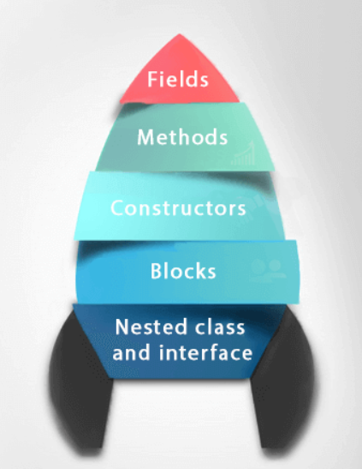
Class
Syntax:
modifier class ClassName
{
Data_members;
Constructors();
Methods();
}

Slide 44
Class Example : Box Class
class Box
{
private private private | double double double | length; width; height;
public { | double | area()
return 2* (length * width + width * height + height * length); } public double volume() { return length * width * height; }
Instance Fields
Methods
}// End of class

Slide 45
Class Example : Box Class
class Box
{
private double
private double private double public double
{
Box
length: double width: double Height: double
+area() : double +volume(): double
Class Name
length; width; height; area()
Attributes
return 2* (length * width + width * height + height * length);
Methods
}
public double
{
volume()
return length * width * height;
}
}// End of class
:Box
Box b1 = new Box();
b1
length | width | height
:Box
Box b2 = new Box();
b2
length | width | height

Slide 46
Class Example : Point
class Point
{
Point
x: double y: double
+getX() : double +getY(): double +setX(value:double):void +setY(value:double):void
private private public | double double double | x; y; getX()
{
 | return | x;
}
public | double | getY()
{
 | return | y;
}
public | void | setX(double value)
{
 | x = value;
}
public | void | setY(double value)
{
 | y = value;
Point p1 = new Point();
:Point
p1
x y
Point p2 = new Point();
:Point
}
}// End of class
p2
x y

Slide 47
Abstraction
Data Abstraction is the property by virtue of which only the essential details are displayed to the user.
The trivial or the non-essentials units are not displayed to the user. Ex: A car is viewed as a car rather than its individual components.
Data Abstraction may also be defined as the process of identifying only the required characteristics of an object ignoring the irrelevant details.
The properties and behaviours of an object differentiate it from other objects of similar type and also help in classifying/grouping the objects.

Slide 48
Encapsulation
Encapsulation is defined as the wrapping up of data under a single unit. It is the mechanism that binds together code and the data it manipulates.
Technically in encapsulation, the variables or data of a class is hidden from any other class and can be accessed only through any member function of own class in which they are declared. As in encapsulation, the data in a class is hidden from other classes, so it is also known as data-hiding.
Encapsulation can be achieved by Declaring all the variables in the class as private and writing public methods in the class to set and get the values of variables.

Slide 49
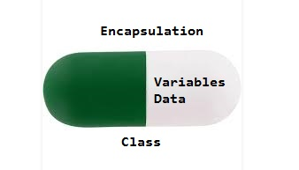
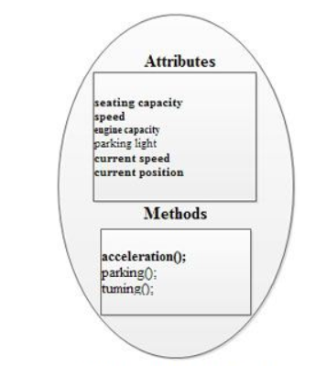
Encapsulation
Methods
16CS5201 / Computer Networks

Slide 50
Polymorphism
Polymorphism is the ability of an object to take on many forms. The most common use of polymorphism in OOP occurs when a parent class reference is used to refer to a child class object.
Any Java object that can pass more than one IS-A test is considered to be polymorphic. In Java, all Java objects are polymorphic since any object will pass the IS-A test for their own type and for the class Object.
It is important to know that the only possible way to access an object is through a reference variable. A reference variable can be of only one type. Once declared, the type of a reference variable cannot be changed.

Slide 51
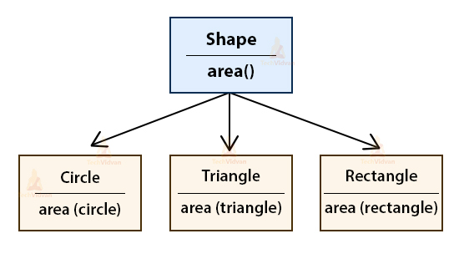
Polymorphism
Polymorphism in Java are mainly of 2 types:
Overloading in Java
Overriding in Java

Slide 52
Inheritance
Inheritance can be defined as the process where one class acquires the properties (methods and fields) of another. With the use of inheritance the information is made manageable in a hierarchical order.
The class which inherits the properties of other is known as subclass (derived class, child class) and the class whose properties are inherited is known as superclass (base class, parent class).
extends Keyword
extends is the keyword used to inherit the properties of a class. Following is the syntax of extends keyword.

Slide 53
Inheritance
Important terminology:
Super Class: The class whose features are inherited is known as superclass(or a base class or a parent class).
Sub Class: The class that inherits the other class is known as subclass(or a derived class, extended class, or child class). The subclass can add its own fields and methods in addition to the superclass fields and methods.
Reusability: Inheritance supports the concept of “reusability”, i.e. when we want to create a new class and there is already a class that includes some of the code that we want, we can derive our new class from the existing class. By doing this, we are reusing the fields and methods of the existing class.

Slide 54
Inheritance
Syntax:
class derived_class extends base_class
{
//methods and fields
}

Slide 55
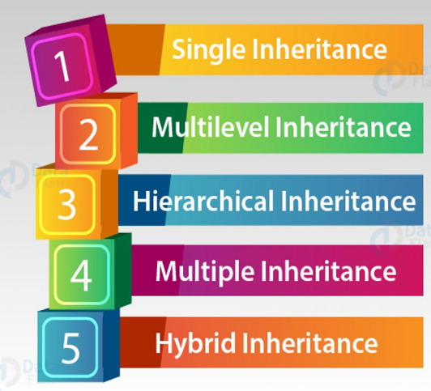
Types of Inheritance

Slide 56
Exercise
Think about the class named ‘Student’. Define its state
and operations
Define the instance fields (attributes) and methods of class named ‘Line’.

Slide 57
JAVA BASICS – Character Set
CHARACTER SET
The character set is a set of alphabets, letters and some special characters that are valid in Java language.
The smallest unit of Java language is the characters needed to write java tokens.
These characters are defined by Unicode character set.
Whenever we write any Java program then it consists of different statements.
Each Java Program is set of statements and each statement is set of different Java programming lexemes.
In Java Programming each and every character is considered as a single lexeme. i.e Basic Lexical Element.
Object Oriented Programming , Lecture 1

Slide 58
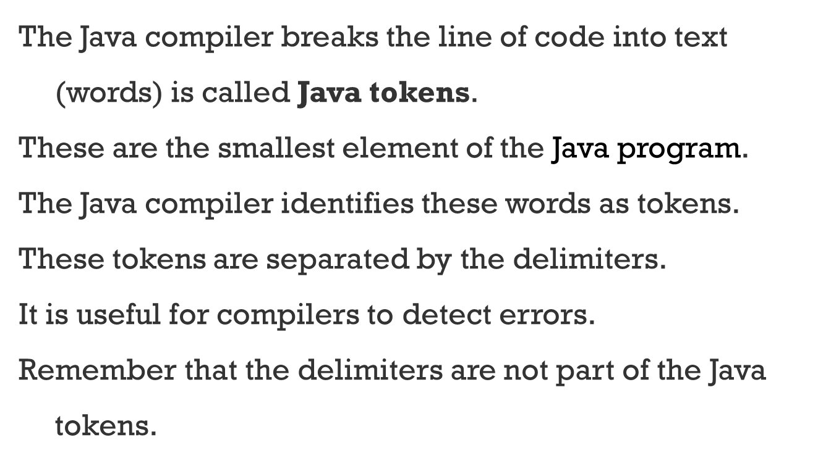
JAVA BASICS – Java tokens
Object Oriented Programming , Lecture 1

Slide 59
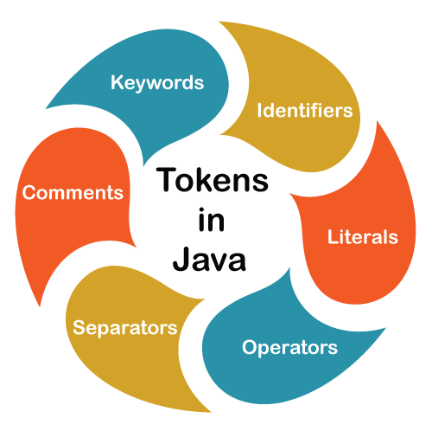
JAVA BASICS – Java tokens
Object Oriented Programming , Lecture 1

Slide 60
JAVA BASICS – Character Set
Alphabets
Java accepts both lowercase and uppercase alphabets as variables and functions.
a.. z and A.. Z
Digits
0,1,…. 9
Special Characters
~ , !, #, $, %, + , - , * , /, %, ( , ), [ , ] , { , } , >, <, ; , : , “, ‘ , ., etc
White spaces
Tab, new line or line space
Object Oriented Programming , Lecture 1

Slide 61
JAVA BASICS – Constants (Literals)
There are several values in the real world which will never change.
A square will always have four sides, PI to three decimal places will always be 3.142, and a day will always have 24 hours.
These values remain constant.
When writing a program it makes sense to represent them in the same way - as values that will not be modified once they have been assigned to a value.
These values are known as constants.
Constants in java are fixed values those that do not change during the Execution of program.
Object Oriented Programming , Lecture 1

Slide 62
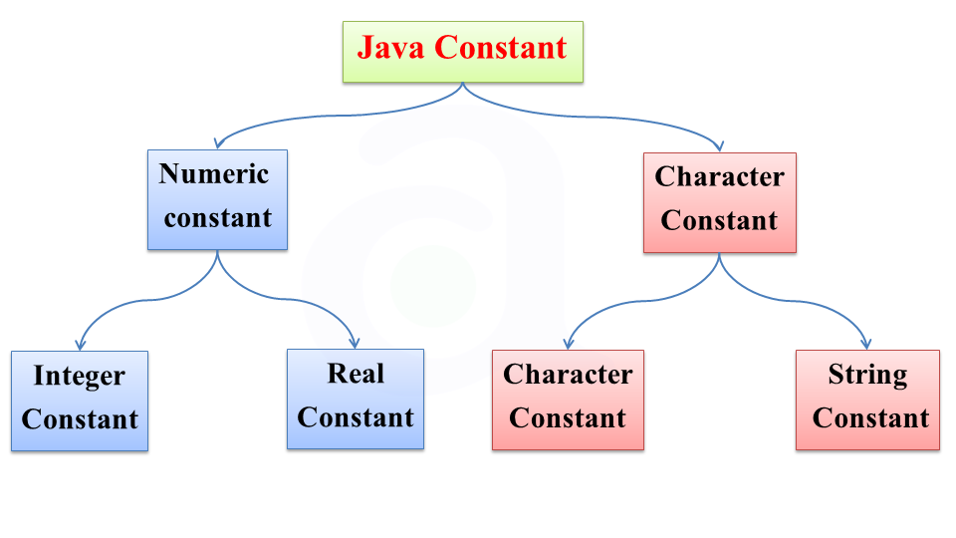
Constants / Literals in Java
1. Integer Constants
2. Real Constants
3. Single Character Constants
4. String Constants
5. Backslash Character Constants
Object Oriented Programming , Lecture 1

Slide 63
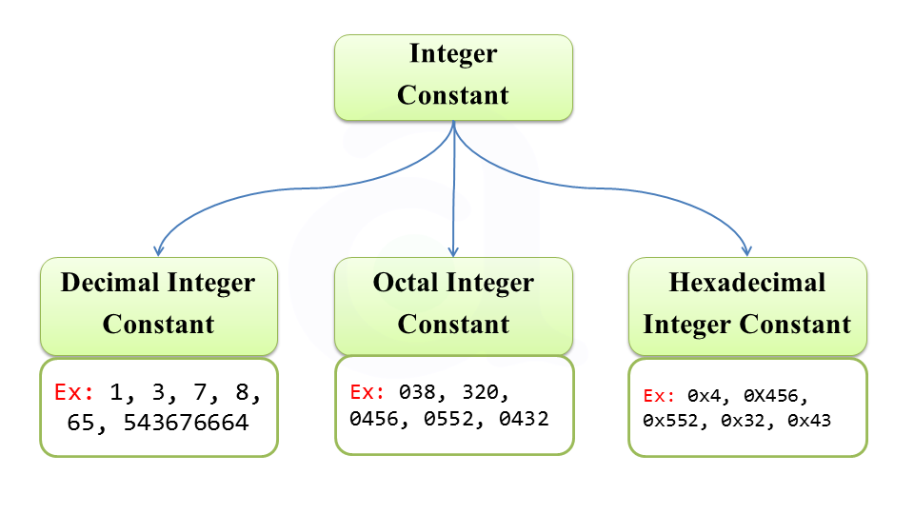
JAVA BASICS - Constants
Integer Constants
Integer Constants refers to a Sequence of digits which Includes only negative or positive Values.
Example
1.Decimal Integer Constants 2.Octal Integer Constants
3.Hexadecimal Integer Constants
Object Oriented Programming , Lecture 1

Slide 64
JAVA BASICS - Constants
An Integer Constant must have at Least one Digit
it must not have a Decimal value
it could be either positive or Negative
if no sign is Specified then it should be treated as Positive
No Spaces and Commas are allowed
Decimal Integer Constants
Decimal constant consists of a set of digits 0 through 9, preceded by an optional –or + sign.
Examples : 234,134,-1,-14567
Octal Integer Constants
An octal integer constant consists of any combination of digits
from the set 0 through 7, with a leading 0.
Object Oriented Programming , Lecture 1

Slide 65
JAVA BASICS - Constants
Examples : o12,o234,o45
Hexadecimal Integer Constants
An octal integer constant consists of any combination of digits
from the set 0 through F, with a leading 0x or 0X.
Examples : ox12,ox4,ox45
Real Constants
Integer numbers are unable to represent distance, height, temperature, price, and so on. These information consist of fractional parts or real parts like 56.890.
Such numbers are called Real or Floating Point Constants
Object Oriented Programming , Lecture 1

Slide 66
JAVA BASICS - Constants
Single Character Constants
A Character is a Single Alphabet, a single digit or a Single Symbol that is enclosed within Single quotation marks.
1. Character Constant Can hold Single character at a time.
2. Contains Single Character Closed within a pair of Single Quote
3. Single Character is smallest Character Data Type in C.
4. It is Possible to Perform Arithmetic Operations on Character Constants
Examples are :
‘A’, ‘c’, ‘l’, ‘1’, ‘&’, ‘:’
Object Oriented Programming , Lecture 1

Slide 67
JAVA BASICS - Constants
String Constants
String is a Sequence of Characters Enclosed between double Quotes
These Characters may be digits, Alphabets Like "Hello", "1234" etc.
1. The string is a "Sequence of Characters".
2. String Constant is written within a Pair of Double Quotes.
3. The string is considered as an Array of Characters.
4. In C, String data type is not available.
Backslash Character Constants
Java Also Supports Backslash Constants (Escape sequence) those are used in output methods For Example \n is used for new line Character
Object Oriented Programming , Lecture 1

Slide 68
JAVA BASICS - Constants
Some of the backslash characters are
\a – Produce bell sound
\b – backspace
\f – form feed
\t – Horizontal tab
\v – Vertical tab
\n – new line
\? – Question mark
\’ – Single quote
\r – Carriage return
Object Oriented Programming , Lecture 1

Slide 69
JAVA BASICS - Variables
Java Variables
A variable is a location in memory (storage area) to hold data.
To indicate the storage area, each variable should be given a unique name (identifier).
Declaration of a variable
A variable is declared as
int speedLimit=80;
Here, speedLimit is a variable of int data type and is assigned value 80.
Meaning, the speedLimit variable can store integer values.
In the example, we have assigned value to the variable during
declaration.
However, it's not mandatory.
Object Oriented Programming , Lecture 1

Slide 70
JAVA BASICS - Variables
We can declare variables without assigning the value, and later we can store the value as you wish.
For example,
int speedLimit;
speedLimit =80;
The value of a variable can be changed in the program, hence the name 'variable’.
For example,
int speedLimit = 50;
speedLimit =80;
Object Oriented Programming , Lecture 1

Slide 71
JAVA BASICS - Naming conventions for Identifiers / Variables-
Java Naming conventions for Identifiers / Variables-
Java programming language has its own set of rules and conventions for naming variables.
Variables in Java are case-sensitive.
A variable's name is a sequence of Unicode letters and digits.
It can begin with a letter, $ or _.
However, it's a convention to begin a variable name with a letter.
Also, variable names cannot use whitespace in Java
Examples
var1, simint, Compound_Interest, output_1_2
Object Oriented Programming , Lecture 1

Slide 72
Java program structure

Slide 73


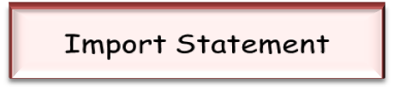



Basic Structure of a Java program
Java programming language is platform-independent and a secure programming language.
A Java program consists of different sections. Some of them are mandatory but some are optional.
The optional section can be excluded from the program depending upon the requirements of the programmer.

Slide 74
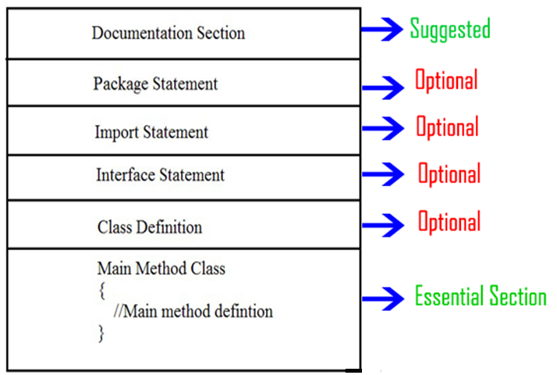
Basic Structure of a Java program

Slide 75
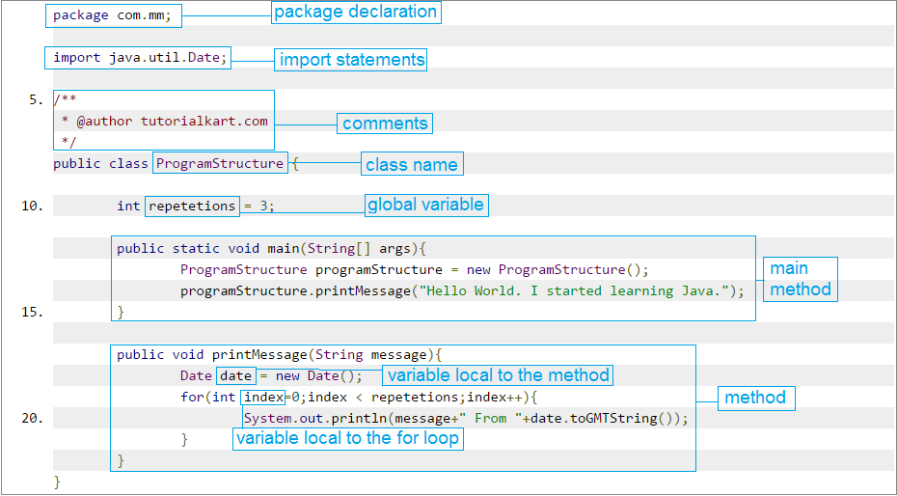
Basic Structure of a Java program

Slide 76
Writing a simple
Java program

Slide 77
A first example
Program:
class HelloWorld
{
public static void main (String args[])
{
System.out.println (“Hello World");
}
}
Output:
Hello World

Slide 78
A first example
/**
Hello World Application
Our first example
*/
public class HelloWorld {
public static void main(String[] args) { System.out.println("Hello World!"); // display output
}
}
$ javac HelloWorld.java
$ ls HelloWorld.class HelloWorld.java
$ java HelloWorld Hello World
7

Slide 79
Structure of a Java program
A Java program is a collection of Java statements.
Each programming language follows a particular syntax for writing a
program.
A Java program has the following sections
Documentation Section
Package Statement
Import Statement Optional Sections
Class definition
Abstract Class Definition
Interface Definition
Class containing the main() method definition
Mandatory for all Java Application programs to contain at least one class having the main method.
Object Oriented Programming , Lecture 1

Slide 80
Thanks

